Slide 1

PRESIDENCY UNIVERSITY
Itagalpura, Bengaluru
COMPUTER PROGRAMMING
MODULE-1

Slide 2
C Language
C is a general purpose programming language developed by Dennis Ritchie at A T & T Bell laboratories
C provides variety of data types.
It also provides control flow constructions like conditional and looping constructs etc..,

Slide 3
SIMPLE C PROGRAM
#include<stdio.h>
Void main()
{
int a,b,c;
printf(“Enter the two numbers a and b\n”);
scanf(“%d%d”,&a,&b);
c=a+b;
print(“The result of a+b is %d\n”,c);
}

Slide 4
Keywords
Words which have predefined / fixed meanings are called keywords.
The meaning of keywords will be known to computer no new name or meaning can be defined for it.
There are totally 32 keywords supported in C

Slide 5
Keywords
auto | double | if | static
break | else | int | struct
case | enum | long | switch
char | extern | near | typedef
const | float | register | union
continue | for | return | unsigned
default | while | short | void
do | goto | signed | while

Slide 6
Identifiers
Identifiers are the name given to the program element.
The program element may be identified as variables, functions and arrays etc..,
These are user defined names and do not have fixed meaning.
It is name given to computer memory location.
Variables – Variables are the identifiers, the named memory location whose value changes on program execution.

Slide 7
Rules to declare an Identifier
First character must be an alphabet or an underscore(_)
First character is followed by any number of letters or digits.
Only first 31 characters are significant
Keywords cannot be used as identifier / variable.
Must not contain blank space/white space
Must contain only alphabets, digits and one special symbol underscore ( _ )

Slide 8
Rules to declare an Identifier
First character must be an alphabet or an underscore(_)
First character is followed by any number of letters or digits.
Only first 31 characters are significant
Keywords cannot be used as identifier / variable.
Must not contain blank space/white space
Must contain only alphabets, digits and one special symbol underscore ( _ )

Slide 9
Constants
Constants are the named memory location; it refers to fixed values that do not change during the execution of a program.
We have different types of constants
1.Integer constant
2. Real constant/Floating Pointing
3. Character constant Ex: ‘a’, ‘9’, ‘\n’
4. String constant Ex: “INDIA”, “8”

Slide 10
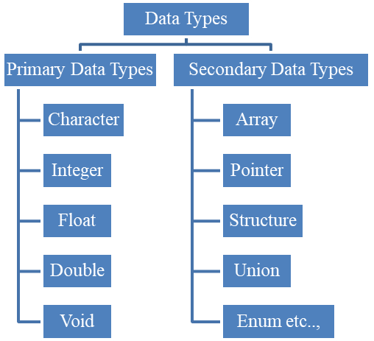
Datatypes
The data type defines the type of data stored in memory location or the type of data the variable can hold.

Slide 11
Format Specifiers
Symbols | Meaning
%i or %d | integer number
%f | float point number
%c | Character
%o | octal number
%x | hexadecimal integer(Lower case letter x)
%X | hexadecimal integer(Upper case letter X)
%e | floating point value with exponent(Lower case letter e)
%E | floating point value with exponent (Upper case letter E)
%g | floating point value with or without exponent
%ld | long integer
%s | String
%lf | double

Slide 12
Escape Sequence
Escape sequence | Meaning
\a | Bell
\ | Beep
\n | new line
\t | tab horizontal
\b | move the character to left one space
\\ | Backslash
\’ | single quote
\” | double quote

Slide 13
Declaration of variables:
The declaration tells the computer which storage locations or variables to use in the program.
The variables which will be used in the program should be declared at the beginning of the program.
The variable declaration indicates the type of constant that the variable can hold and the amount of memory allocated to the variable.
The name of the variables should be declared as per the rules of declaring identifiers or variables.
datatype variable;
(or)
datatype variable1, variable2,……..variable_n;

Slide 14
printf() and scanf()
printf (“Text/format-control-string”[,other-arguments]);
scanf(“Format Specifier”,&variablename)

Slide 15
Structure of C program
Comments/Documentation Section
Preprocessor Directives
Global Declaration Section
void main( ) [Program Header] { Local Declaration part Execution part Statement 1 ------------ ------------ Statement n }
User Defined Functions

